Slide 1
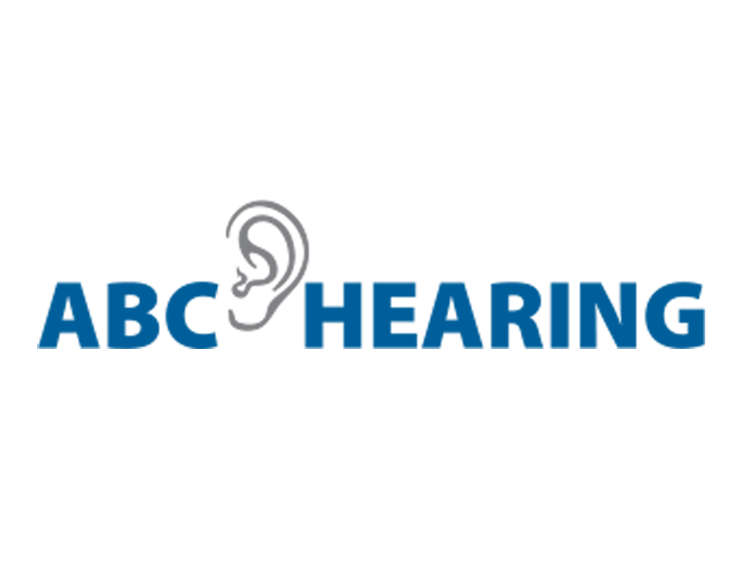
Why a Lifestyle Medicine Physician (LMP) – Audiologist Partnership?

Slide 2

What is age-related hearing loss?

Slide 3

How common is it?

Slide 4

Why is it referred to as a “hidden handicap”
Occurs slowly as we age
Our knowledge of language (ability to fill in the blank) helps us compensate
Stigma related to aging
Easy, even normal to delay treatment

Slide 5
The Triple Threat of Untreated Hearing Loss
Hearing loss has a negative impact on three key areas of health and well-being:
1
2
3
Daily communication and lifestyle. Nearly all interactions are negatively impacted by hearing loss. This often leads to a less vigorous and active lifestyle.
Social Consequences. Hearing difficulties can lead to withdrawal from social interactions, increasing the risk of loneliness and depression.
Cognitive Consequences and Risk of Falls. Untreated hearing loss has been linked to an increased risk of cognitive decline and dementia. Hearing loss is also associated with reduced environmental awareness and balance issues, which can lead to a higher risk of falls.

Slide 6
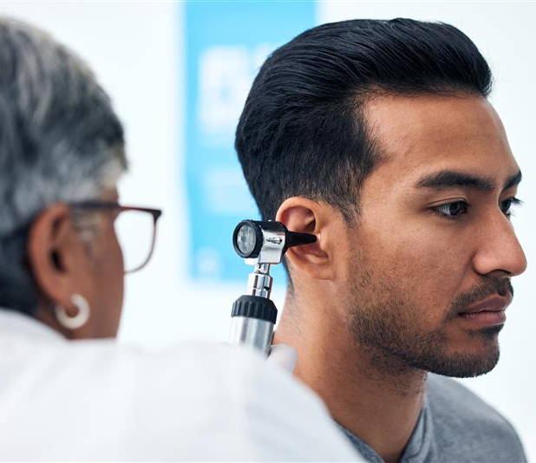
The value of early identification and intervention
People who are encouraged to get a hearing test tend to be more empowered about their care.
People who take early action tend to experience better outcomes with hearing aids.

Slide 7

Intervention Strategies
Hearing protection devices
OTC hearing aids (DIY care)
Prescription hearing aids
Cochlear rehab
Professional services/rehab

Slide 8

The role of the Lifestyle Medicine Physician
Empower/encourage individuals to get a periodic hearing test
Follow the AAO-HNS screening recommendations
Educate with the ADA toolkit

Slide 9

The role of the Audiologist
Complete comprehensive hearing assessment on those failing the hearing screening
Report results to LMP
Provide follow-up care as needed
Re-fresh patient toolkit as needed
Keep LMP’s staff updated on hearing care trends

Slide 10
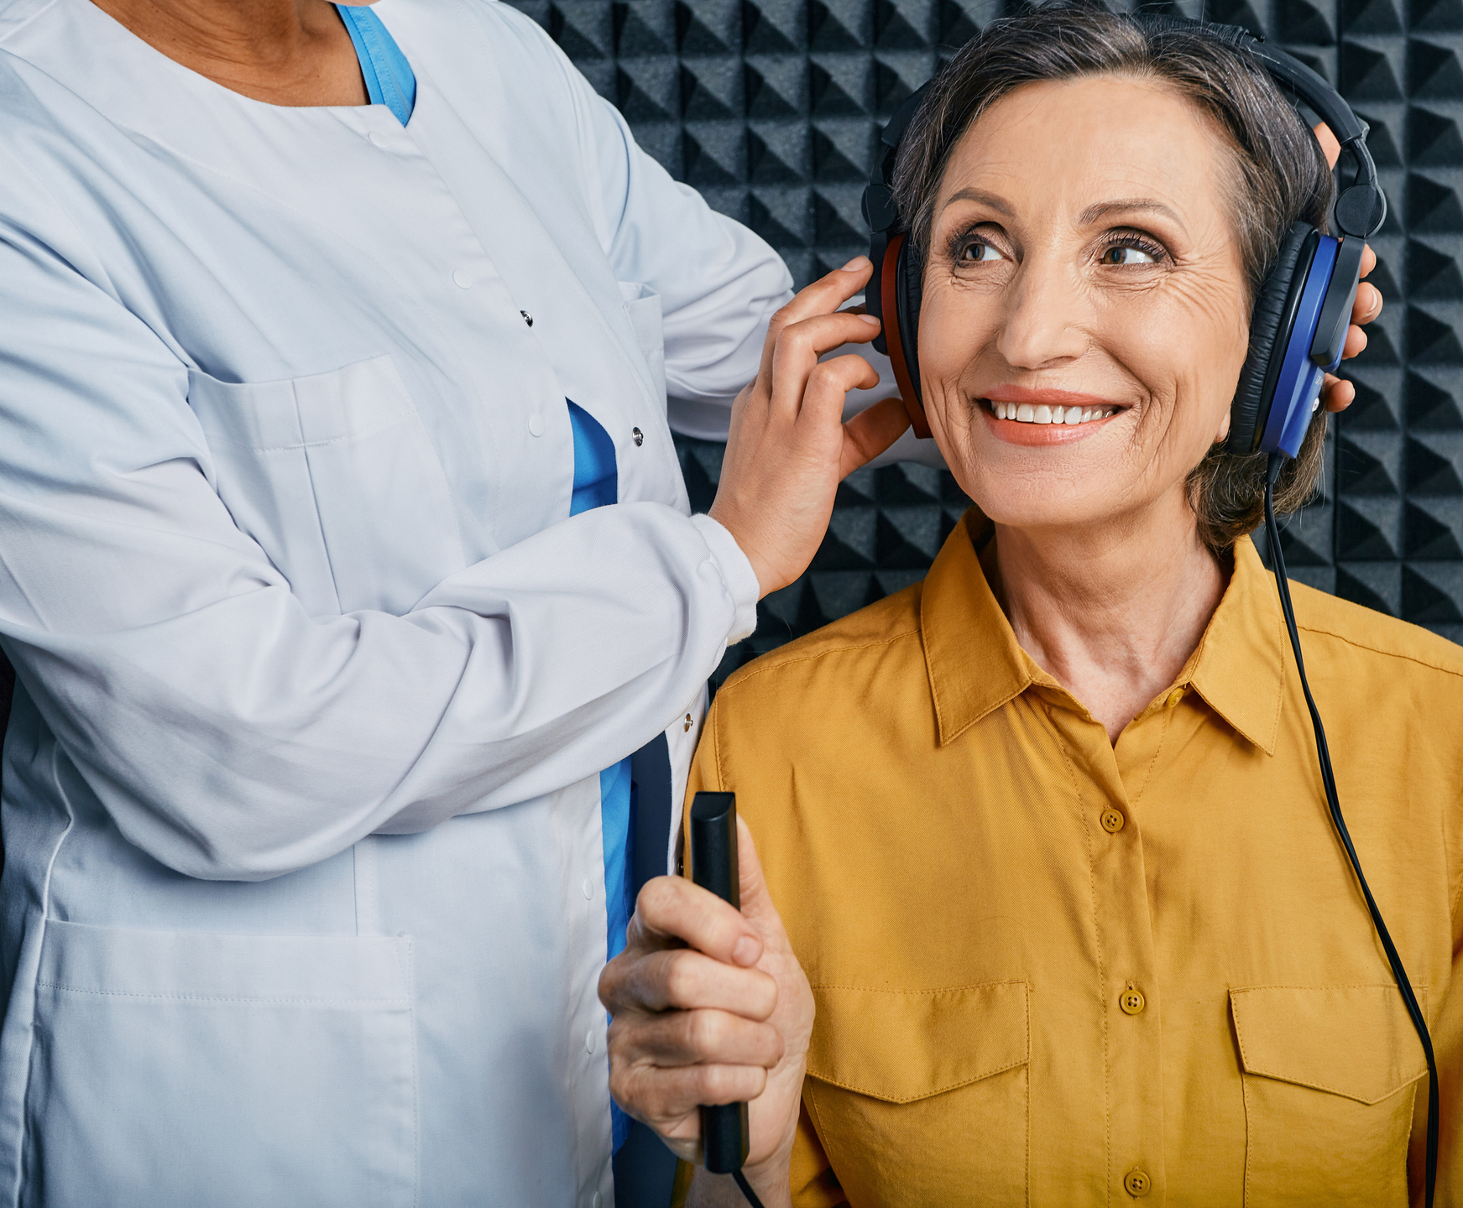
Sample Workflow
Patient Visit at Lifestyle Medicine Clinic
Digital Hearing Screening/Self-report Administered
Screening Results Reviewed by LMP
If needed - Referral Sent to Local Audiologist
Audiologist Completes Diagnostic Evaluation
Care Report Shared with LMP
Individual’s (patient) Lifestyle Plan Adjusted (if applicable)

Slide 11

Getting started
Add a question about hearing loss and getting a hearing screening to your in-take interview (add it to your EMR workflow)
“The US Academy of ENT Surgeons recommends that all adults over age 50 get a periodic hearing test. Have you had a hearing test in the past year?”
Encourage individuals to take worksheets/flyers home
Encourage self-testing and self-assessment of hearing

Slide 12

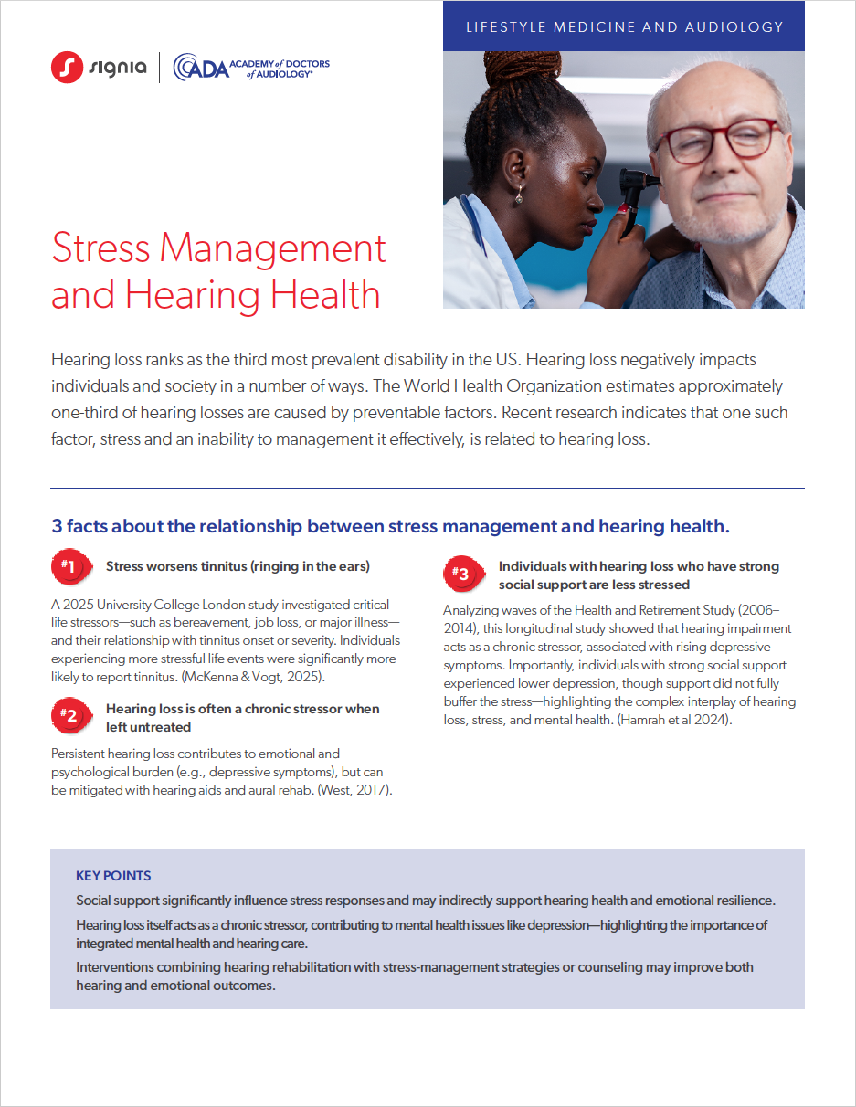
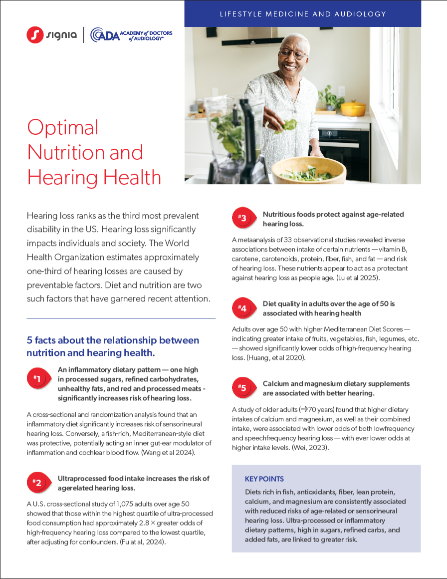
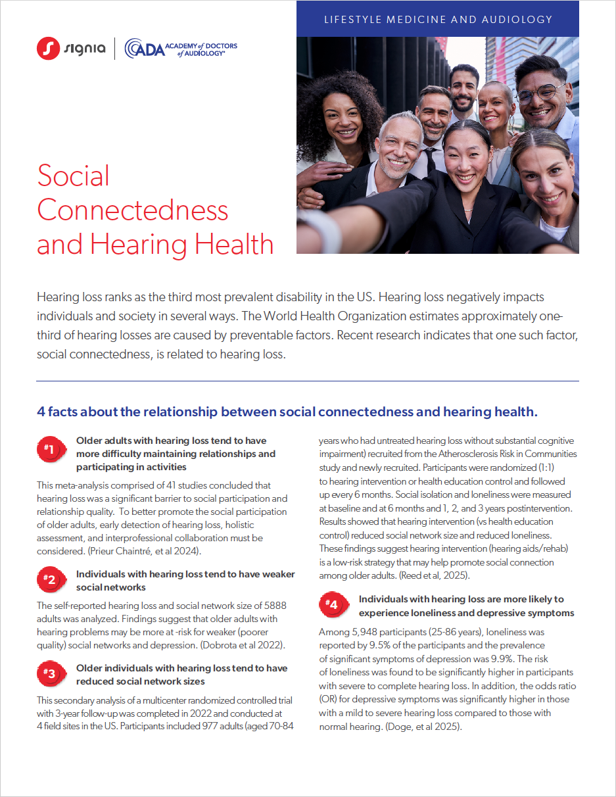
Helpful Resources for Your Practice

Slide 13
References
Lin, F. R., Metter, E. J., O'Brien, R. J., Resnick, S. M., Zonderman, A. B., & Ferrucci, L. (2011). Hearing loss and incident dementia. Archives of Neurology, 68(2),
Mick, P., Kawachi, I., & Lin, F. R. (2014). The association between hearing loss and social isolation in older adults. Otolaryngology–Head and Neck Surgery, 150(3), 378–384.
Viljanen, A., Kaprio, J., Pyykkö, I., et al. (2009). Hearing as a predictor of falls and postural balance in older female twins. Journals of Gerontology: Series A, 64(2), 312–317.

